Slide 1

Team Orange
Omkar Vartak
Sindhuja Pulumati
Shweta Sawant
Riya Sarode
Mihir Zala
Kavya Nallajerla

Slide 2
OMKAR VARTAK YEAR 1987

Slide 3
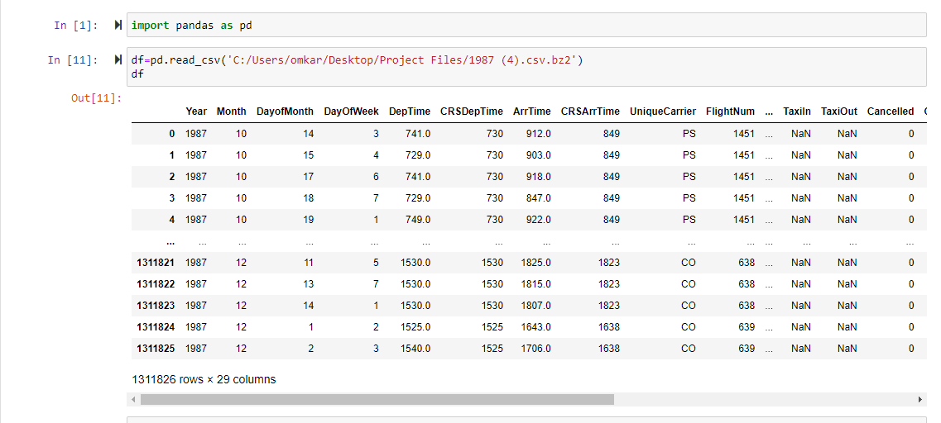
Selecting Random 1000 records from aSSIGNED YEAR 1987

Slide 4
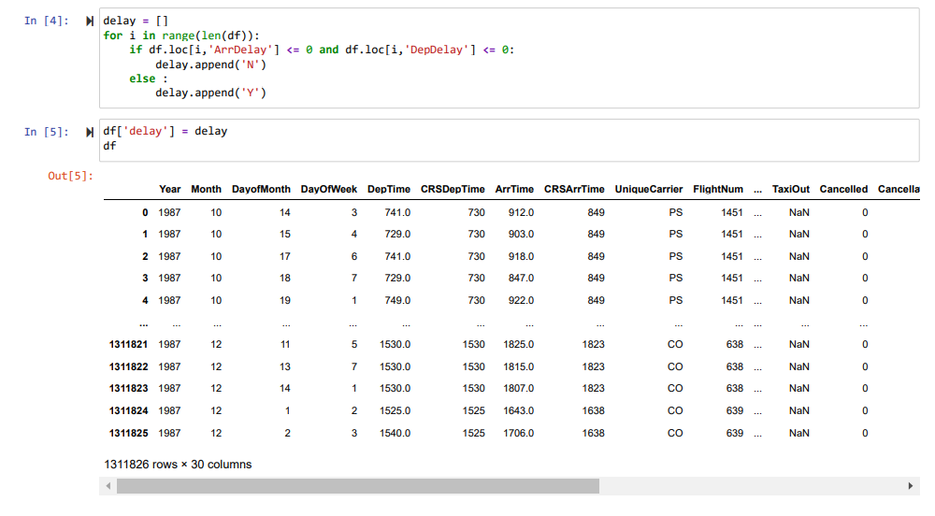
Adding the Delay Column, And if the record has a value of zero or less in the ArrDelay and DepDelay updating columns by Inserting a “N” in the Delay column Otherwise update it With "Y".

Slide 5
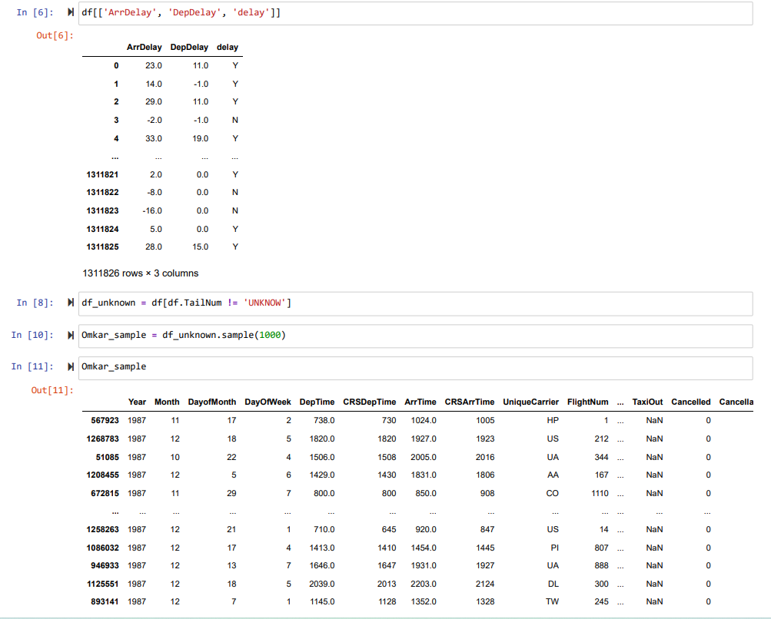
SUCCESSFULLY Importing the Updated file to THE System.

Slide 6
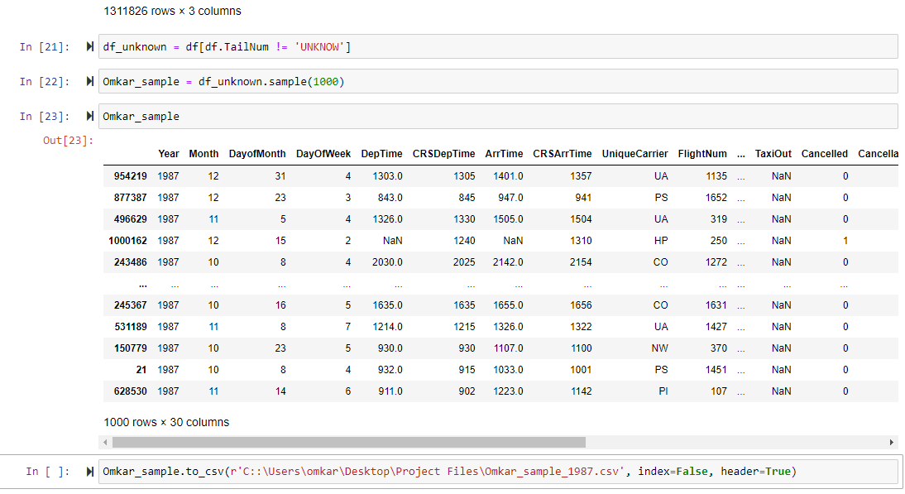
Saving to the local system.

Slide 7
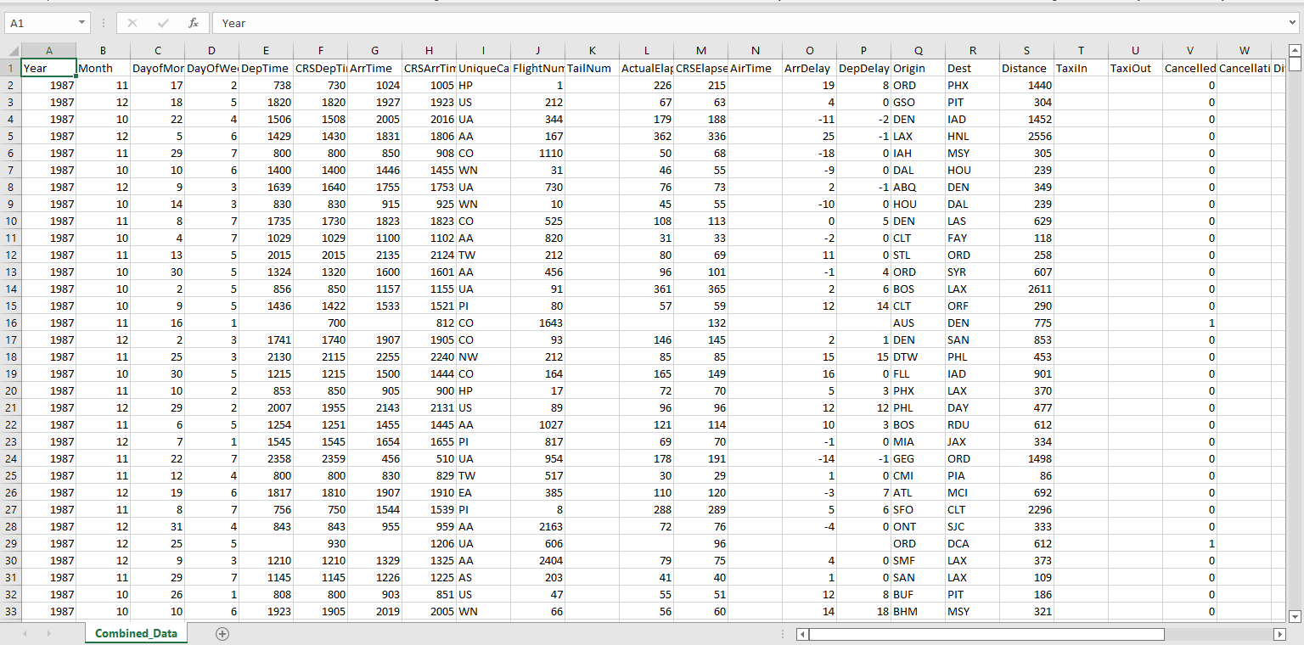
COMBINING the Data from All the USers Year 1987

Slide 8
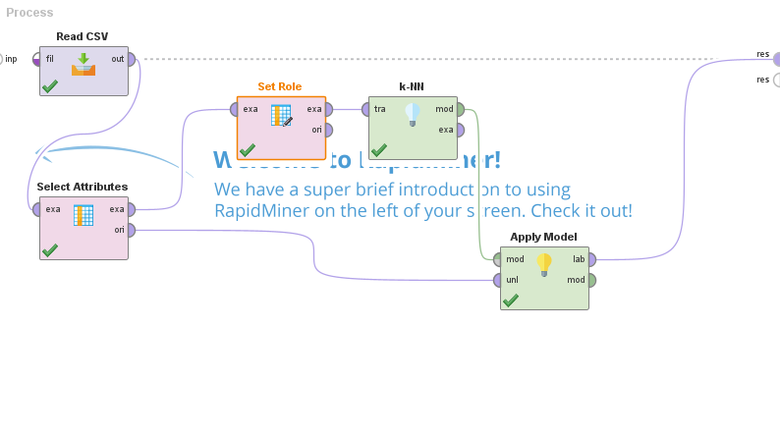
Importing the data into rapid miner For Case 1 Year 1987

Slide 9
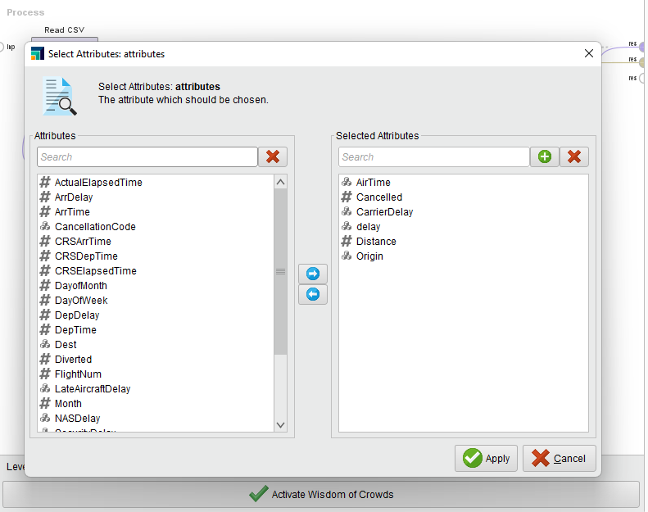
Attributes for Case 1

Slide 10
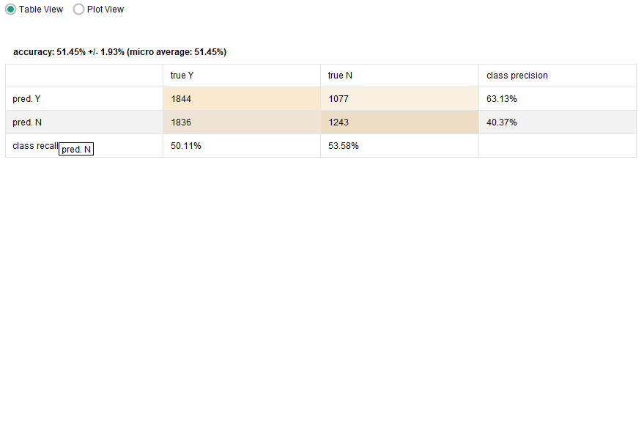
Accuracy for Combined cases

Slide 11
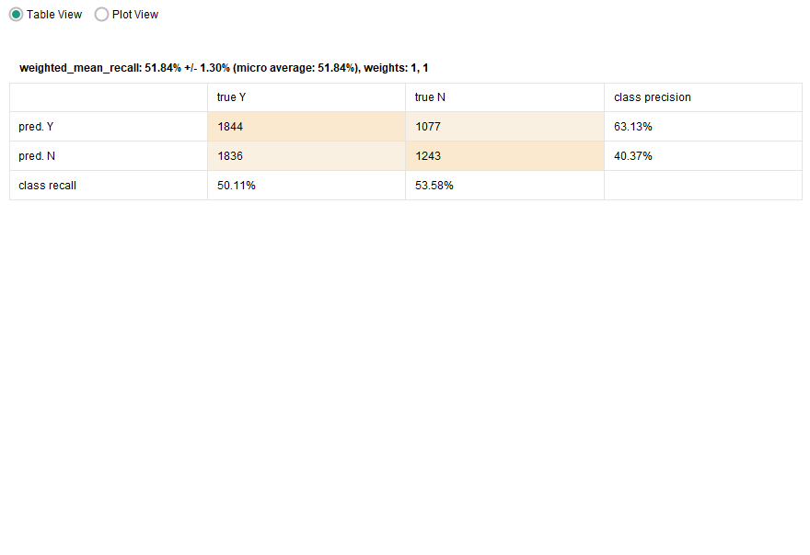
Recall For combined Cases

Slide 12
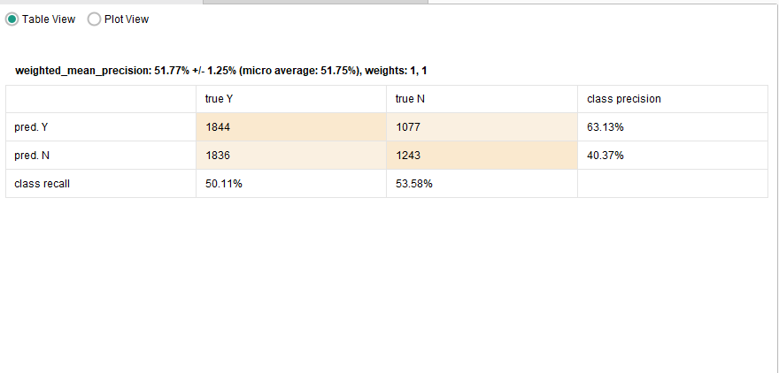
Mean for combined cases

Slide 13
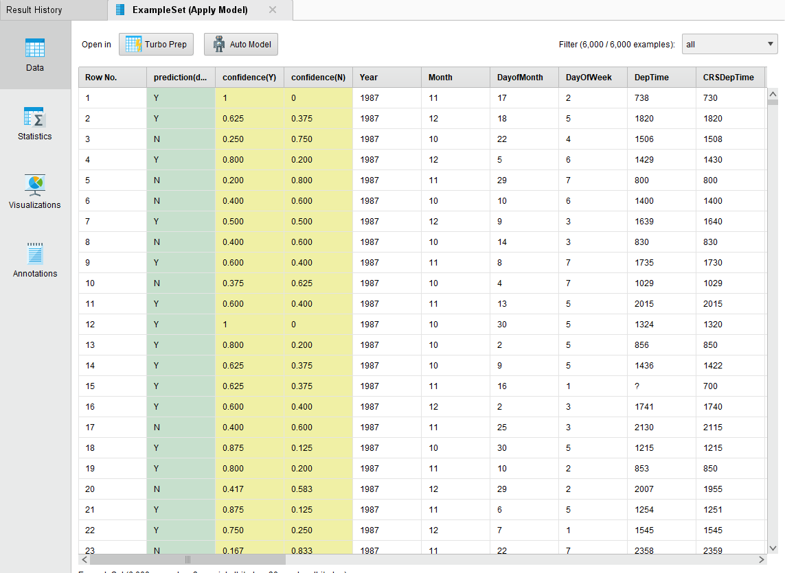
The Result That we got after executing

Slide 14
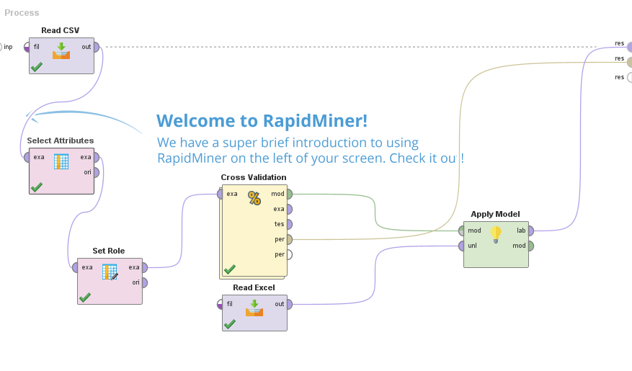
Case for 12 records.

Slide 15
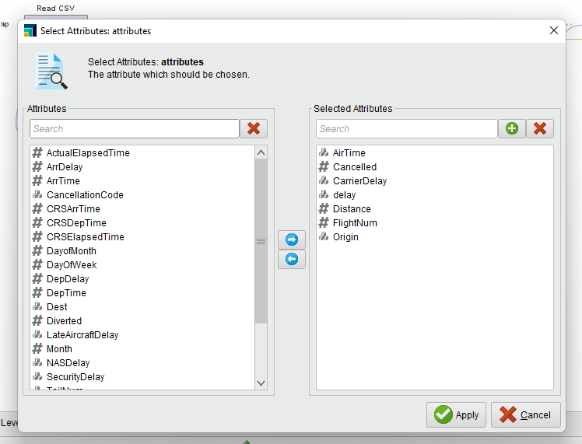
Attributes Taken for 12 Case records

Slide 16
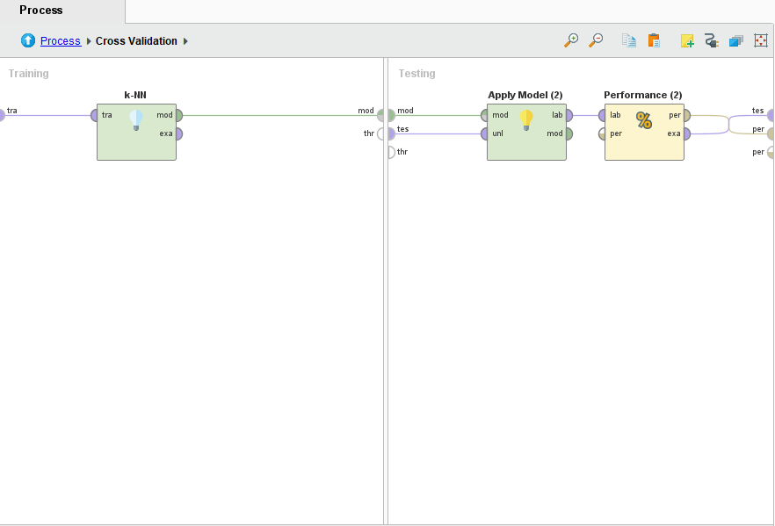
Implementation of kNn algortihm Year 1987

Slide 17
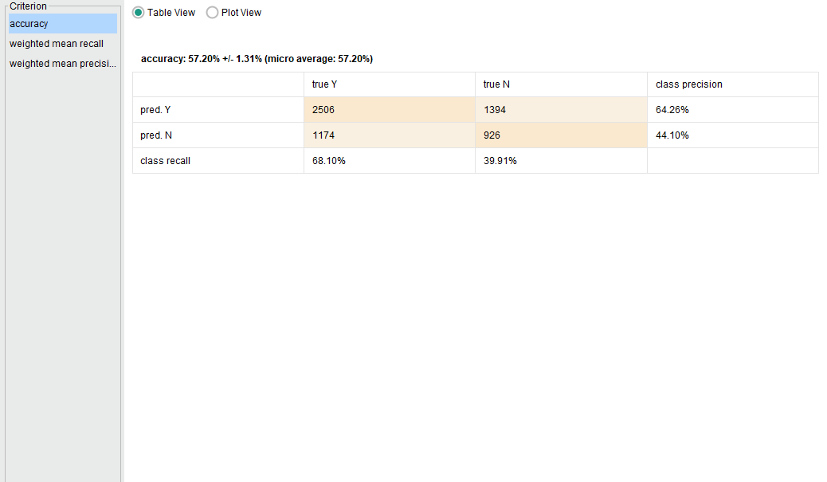
Accuracy Result for 12 CAse records

Slide 18
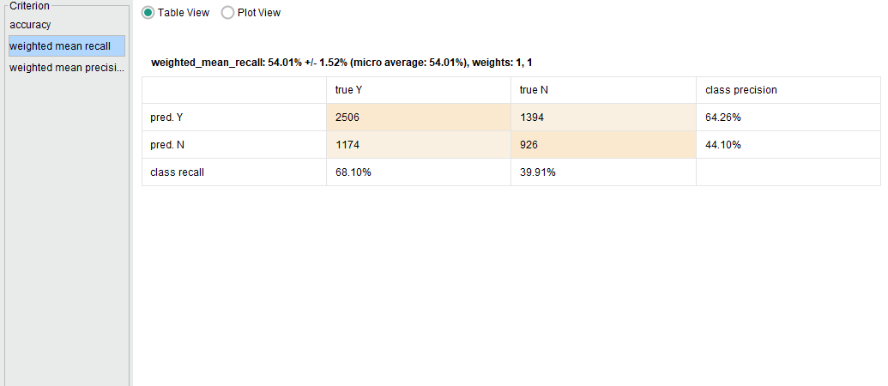
Recall RESULT FOR 12 CASE RECORDS

Slide 19
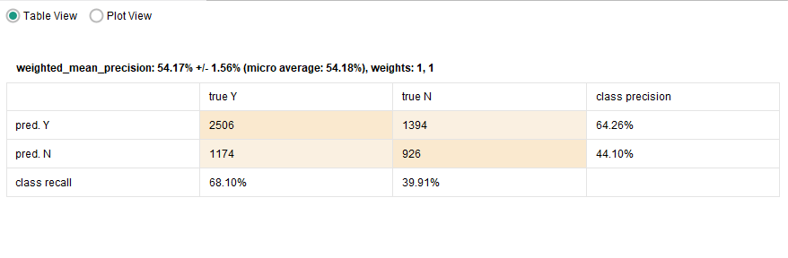
Precision RESULT FOR 12 CASE RECORDS

Slide 20
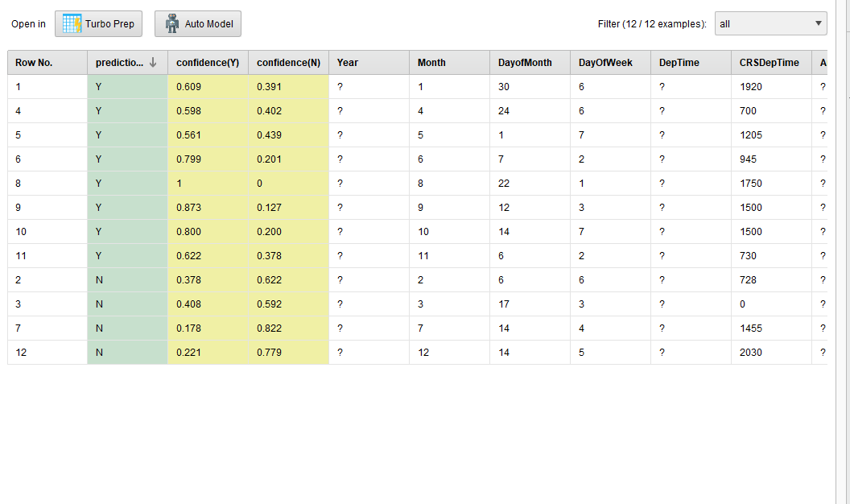
Output for using the following model YEar 1987

Slide 21
MIHIR ZALA Year 1989

Slide 22
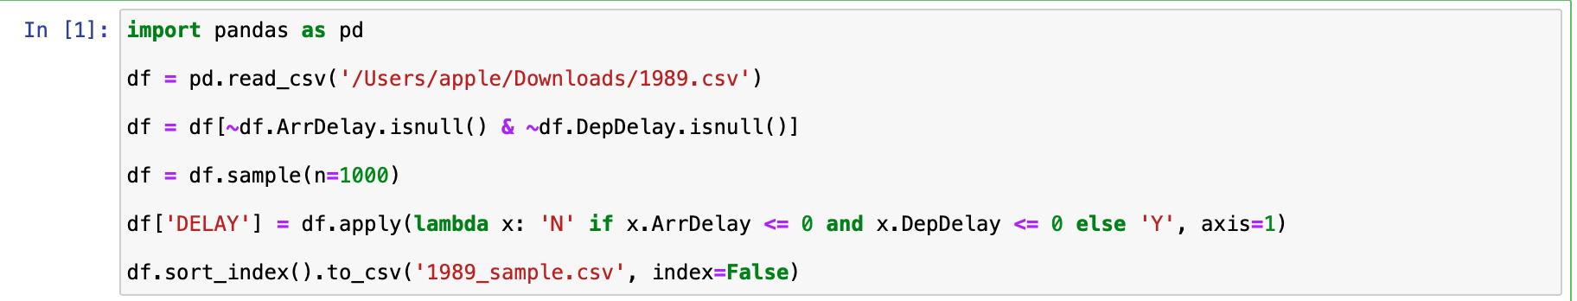
CODE FOR SELECTING 1000 RANDOM RECORDS FOR YEAR 1989

Slide 23
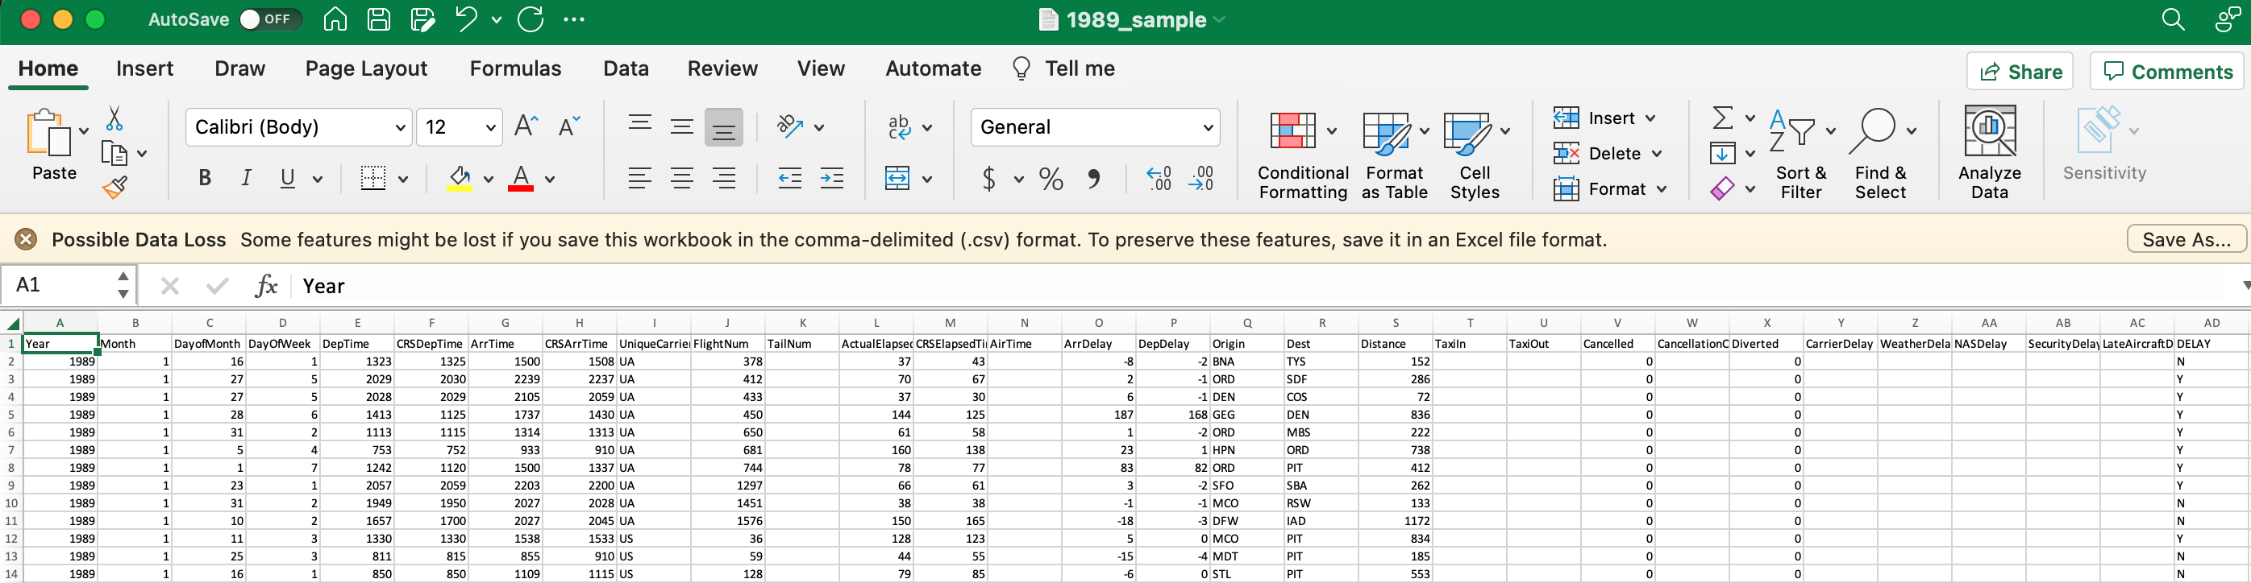
DISPLAYING SAMPLE DATA IN EXCEL FOR YEAR 1989

Slide 24
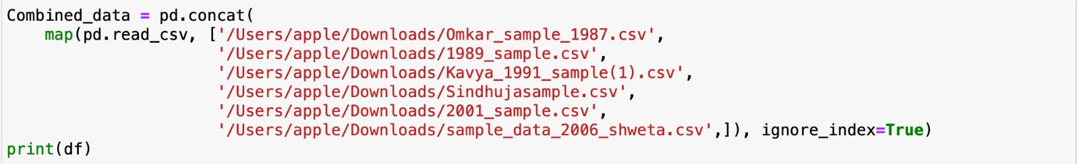
COMBINING DATA FOR ALL THE YEARS

Slide 25
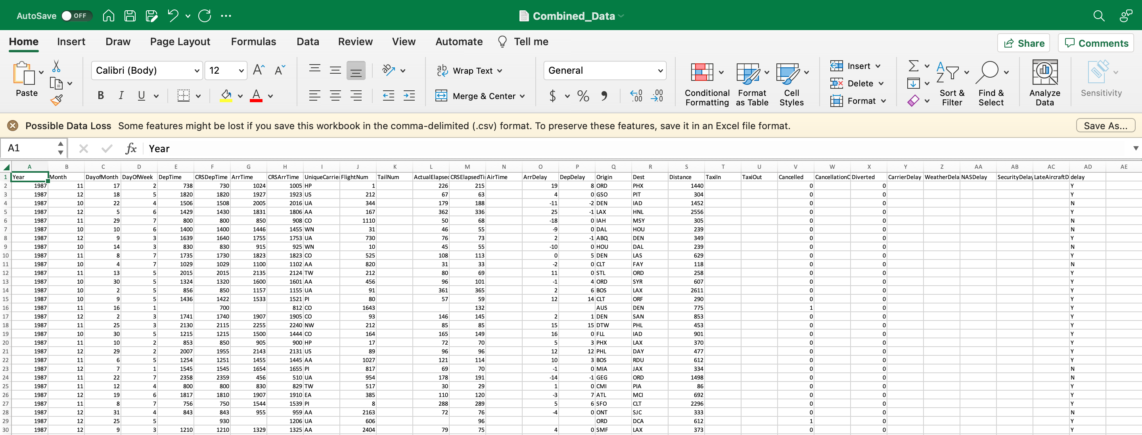
COMBINED DATA FILE IN EXCEL

Slide 26
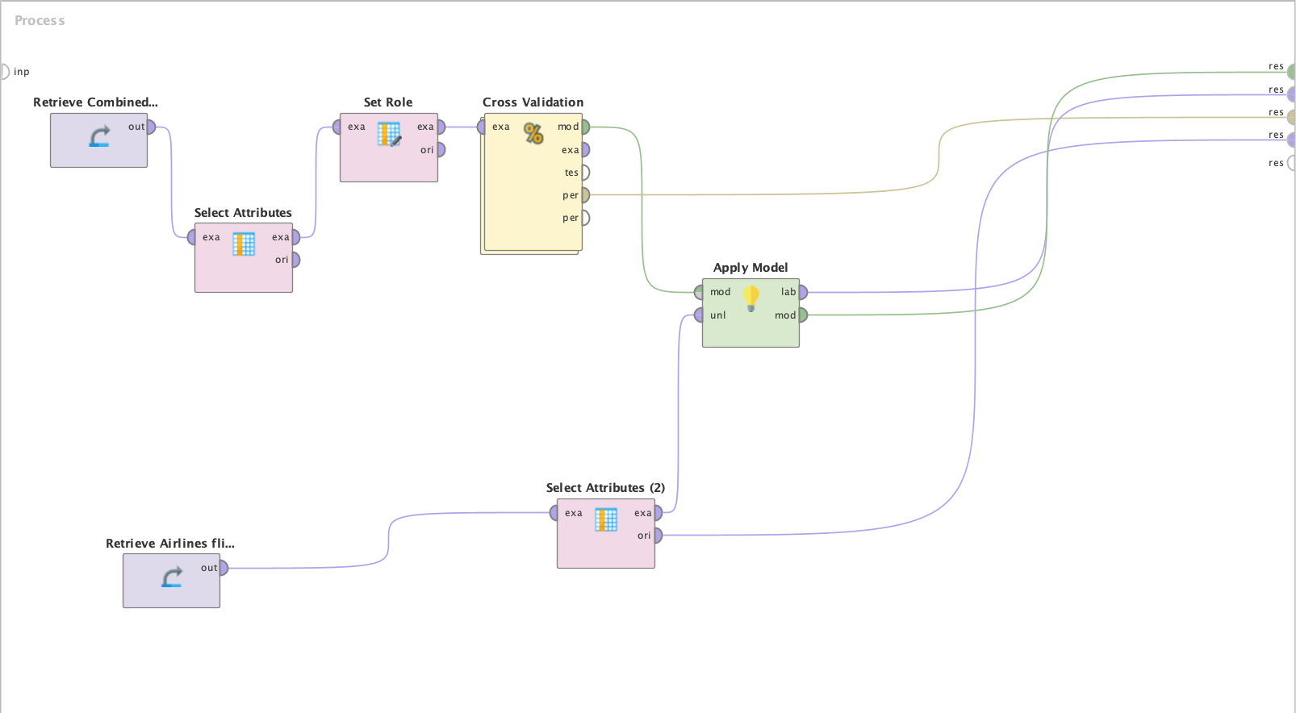
IMPORTING DATA IN RAPIDMINER

Slide 27
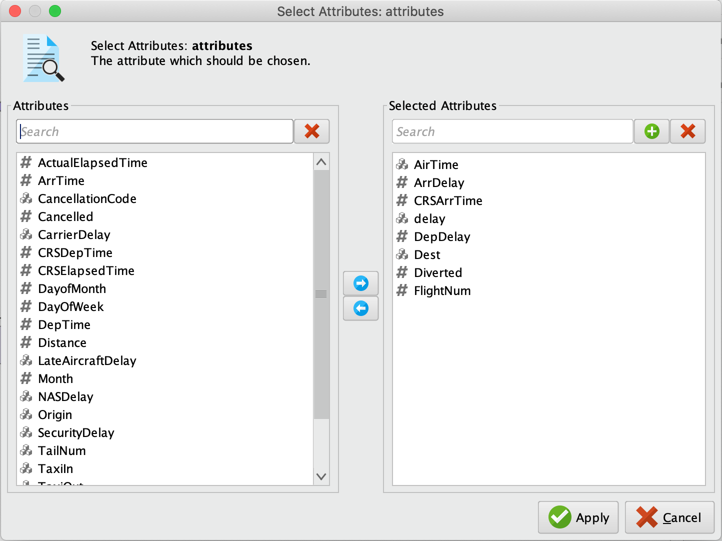
ATTRIBUTES SELECTION

Slide 28
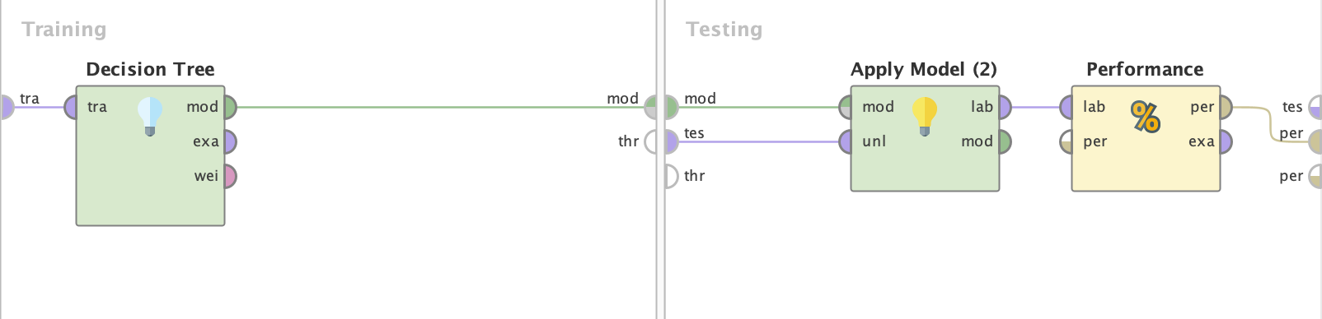
CROSS VALIDATION

Slide 29
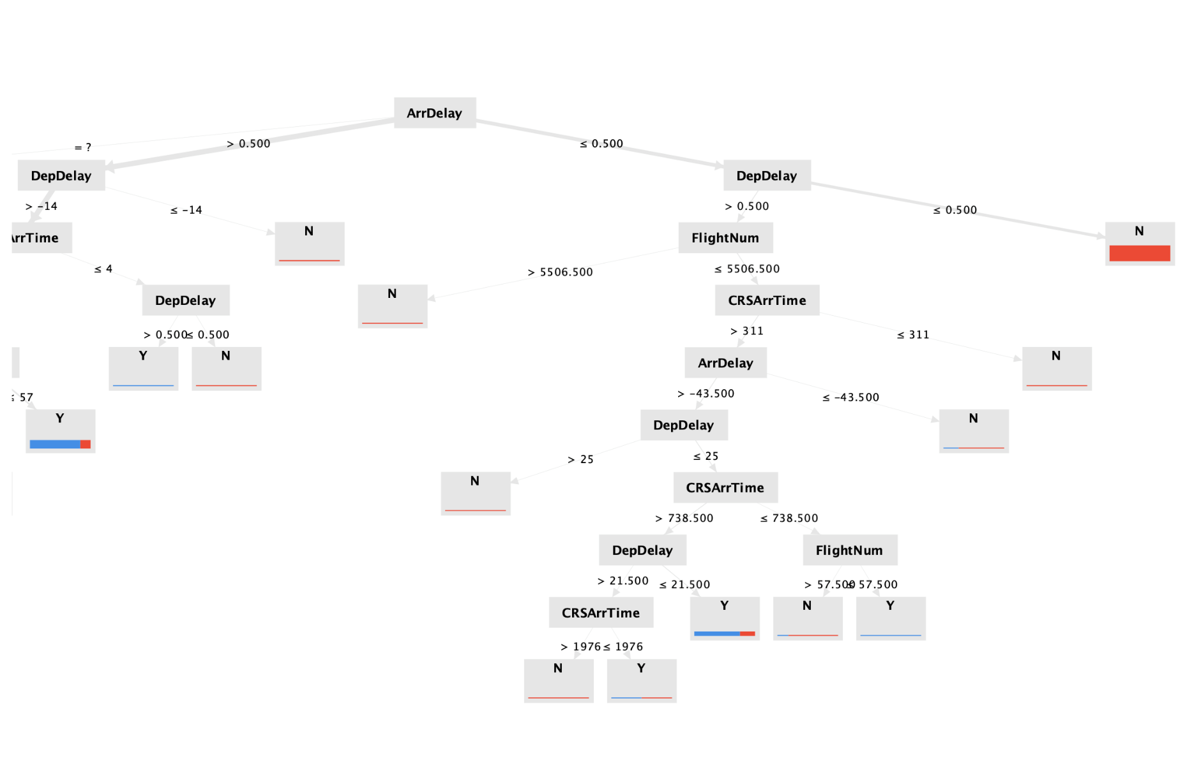
GRAPH OF DECISION TREE MODEL

Slide 30
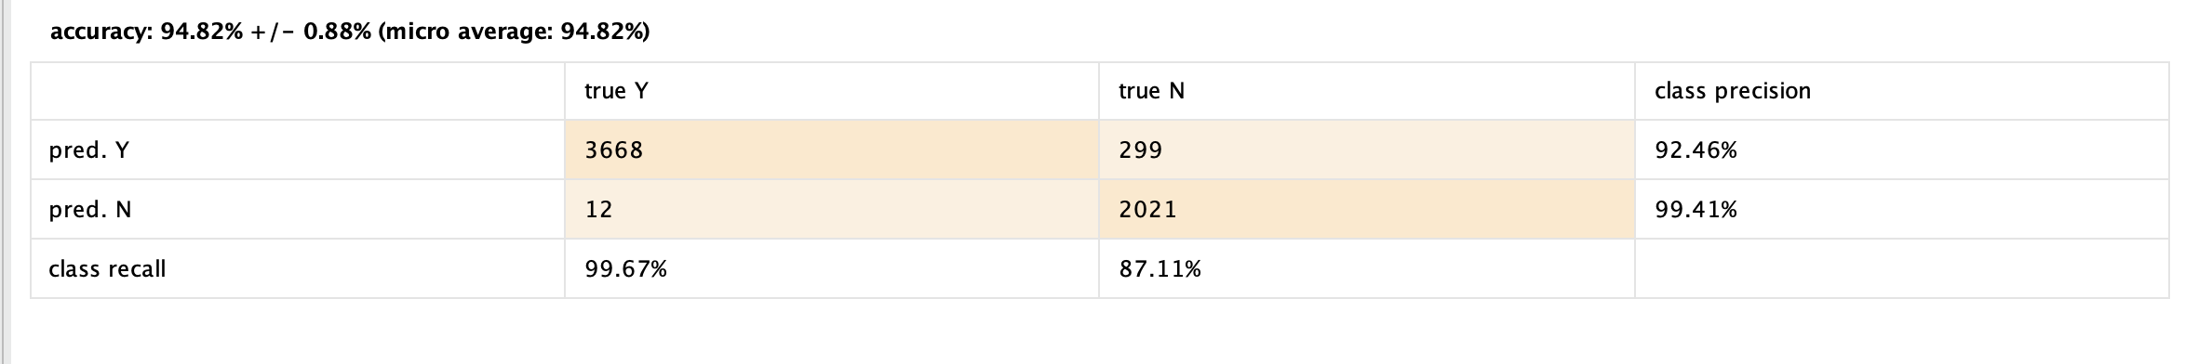
PERFORMANCE VECTOR

Slide 31
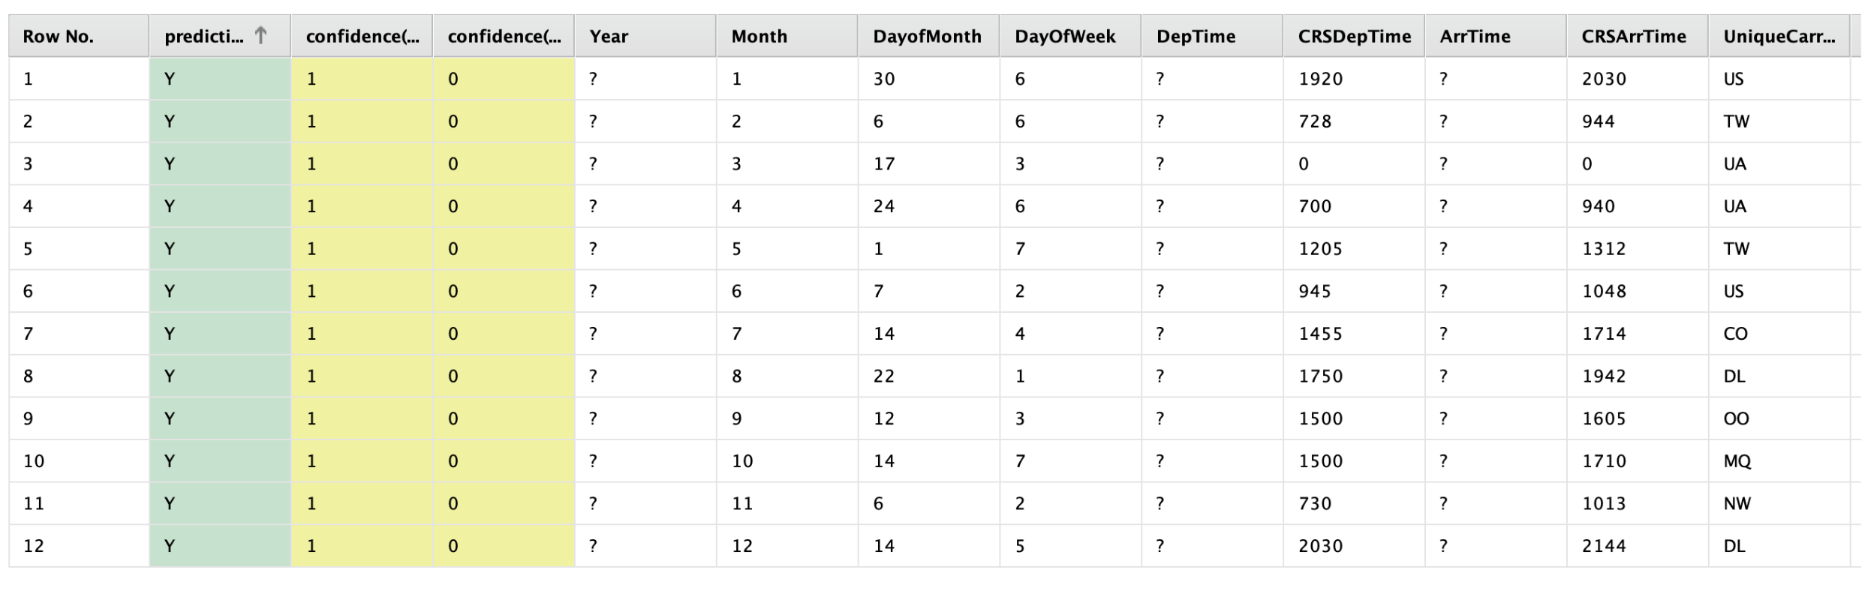
TESTING THE EXAMPLE DATA

Slide 32
KAVYA Nallajerla
Year 1991

Slide 33
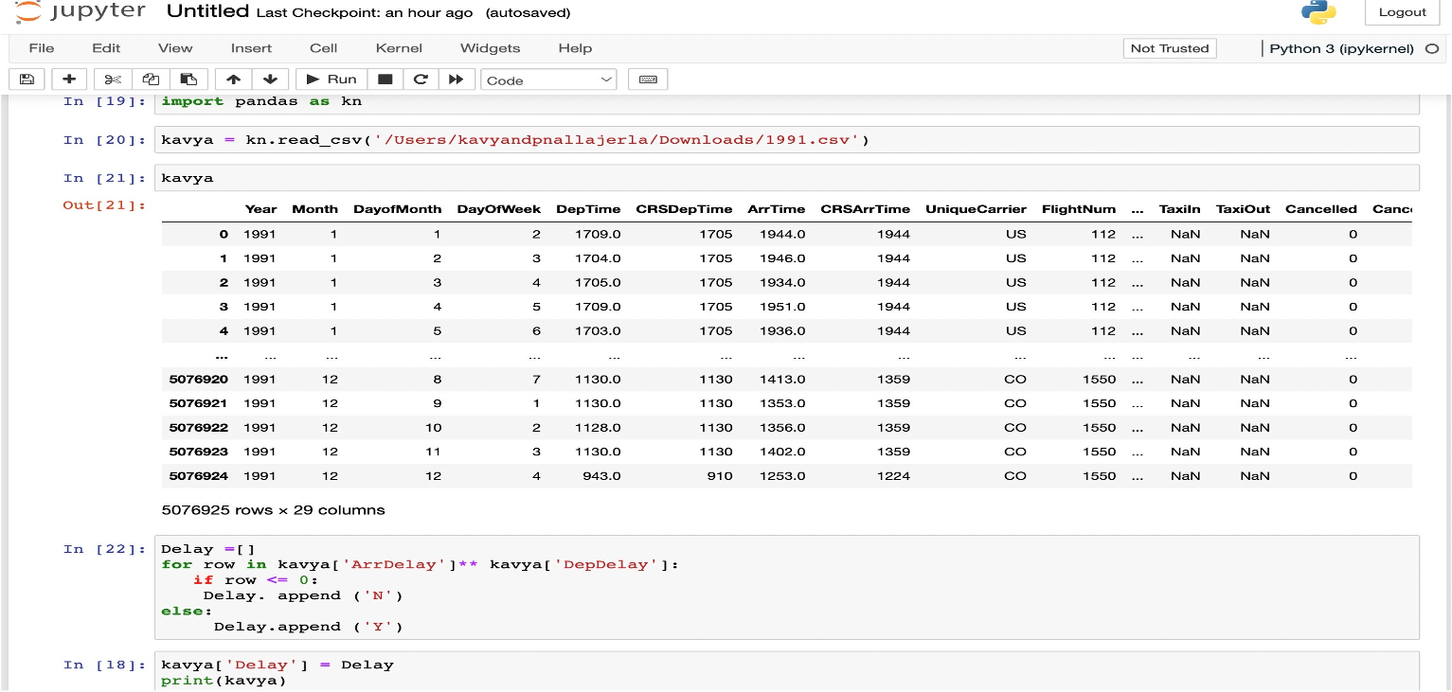
SELECTING SAMPLE 1000 RECORDS Of year 1991

Slide 34
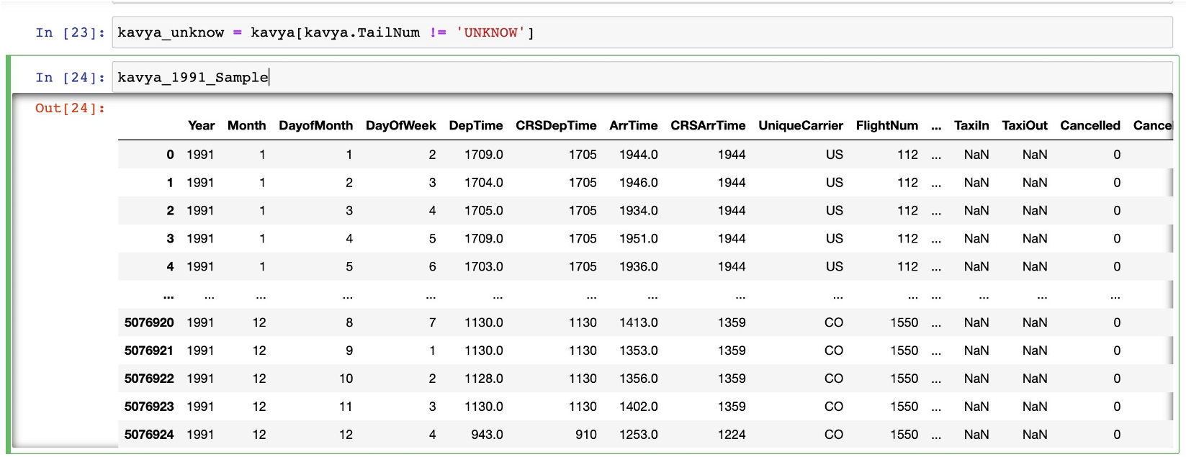
Importing the Updated sample data to the system

Slide 35
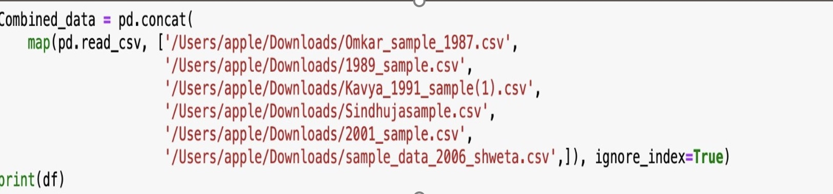
Combining data from all years

Slide 36
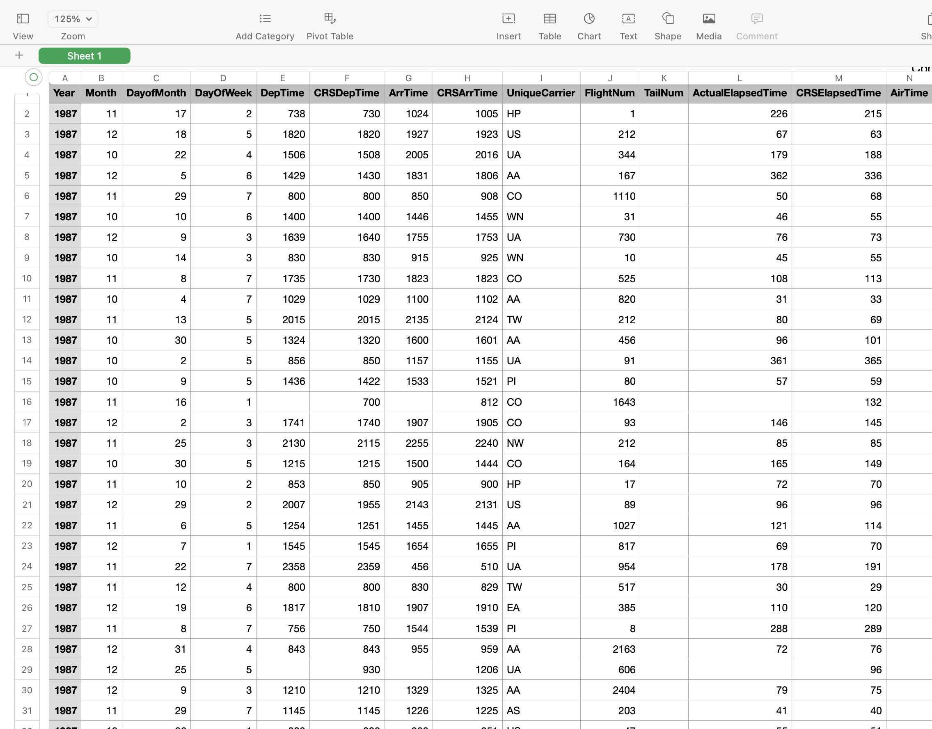
Combining data from all the sample years from team orange

Slide 37
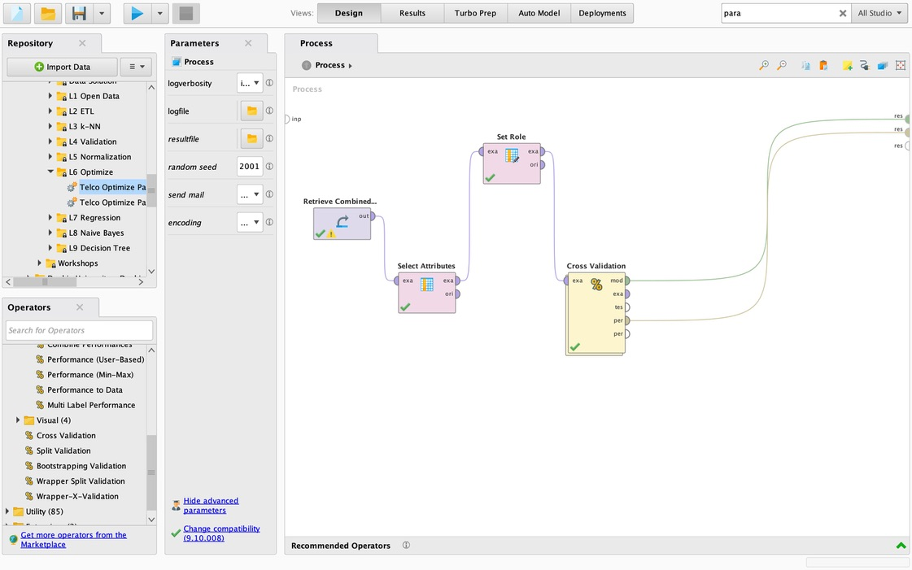
Importing Combined sample Data and Designing it with process, training ,Testing

Slide 38
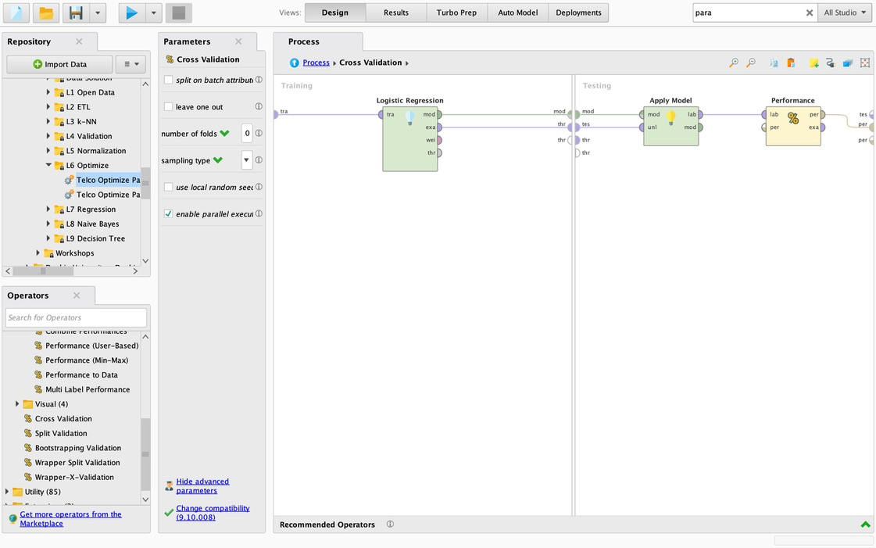
Cross validation for logistic regression model and testing performance

Slide 39
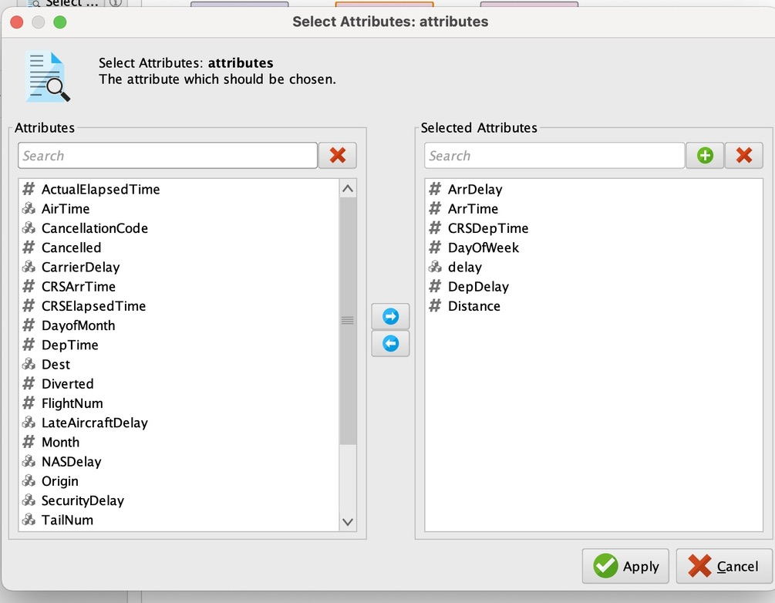

Slide 40
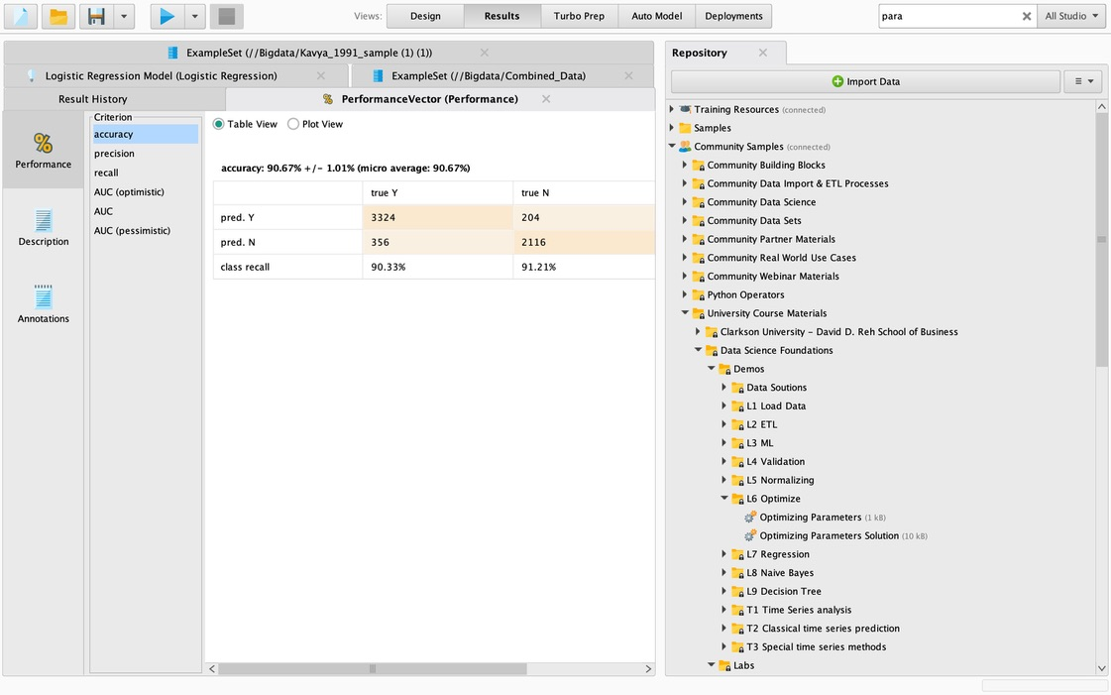
Accuracy-90.67% ,Precision ,Recall Logistic Regression model

Slide 41
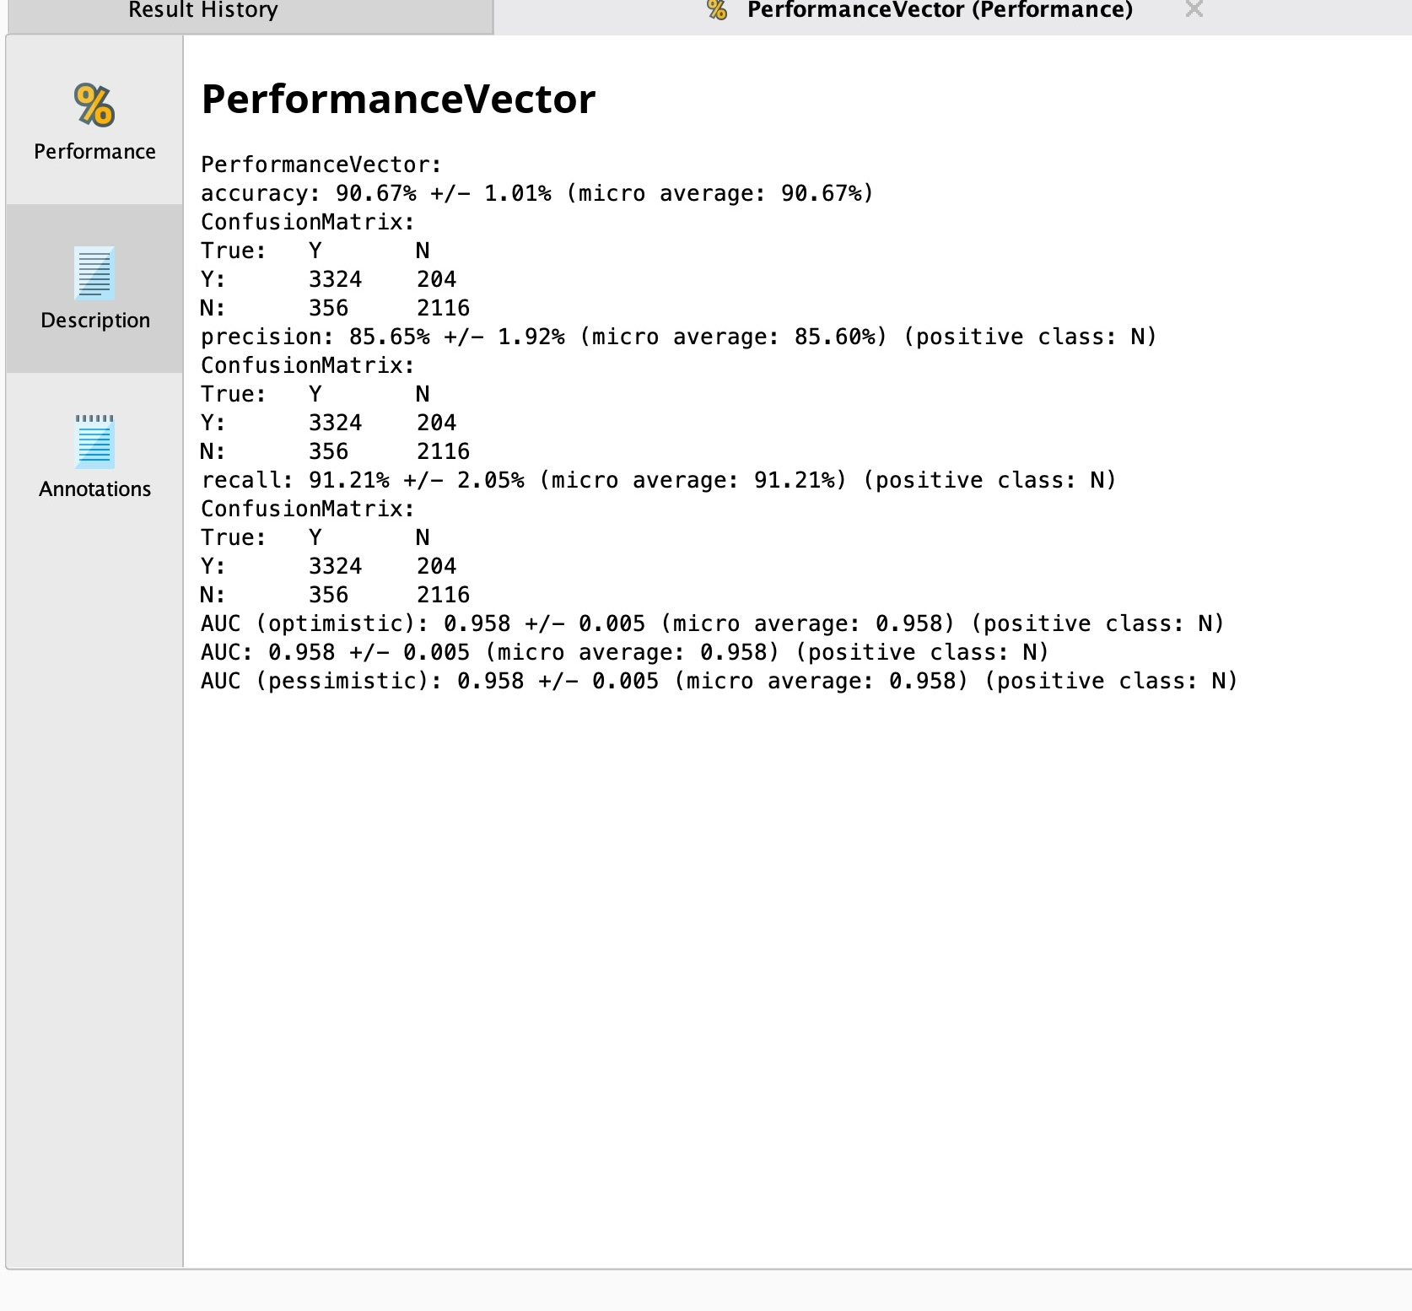
Performance vector

Slide 42
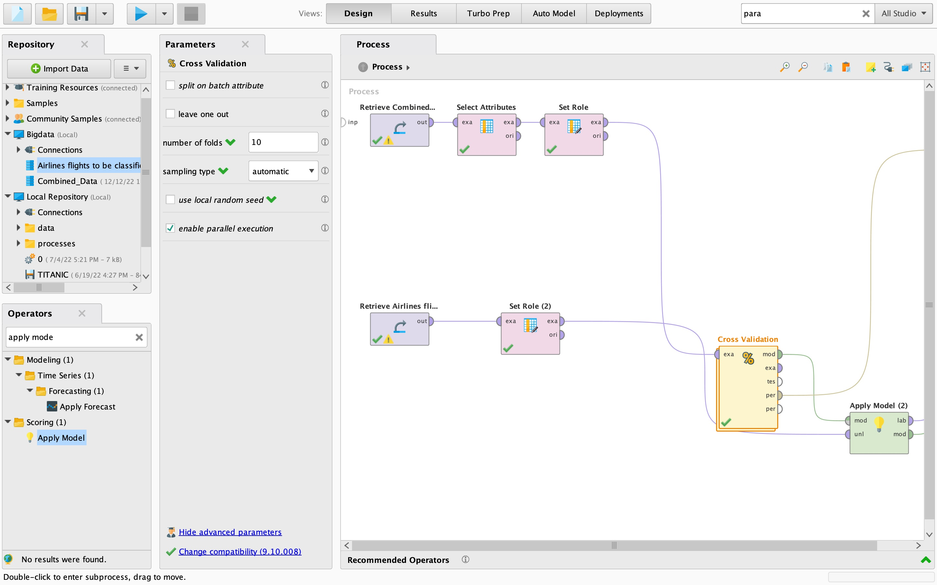
Importing the data for 12 records

Slide 43
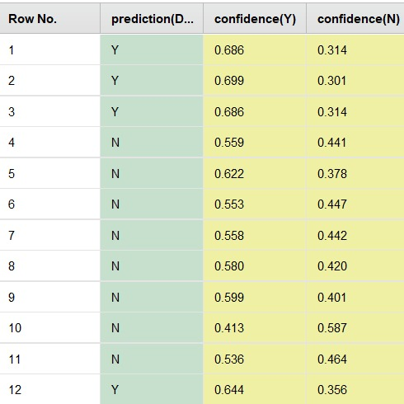
Example set values

Slide 44
SINDHUJA PULUMATI – YEAR 1996

Slide 45
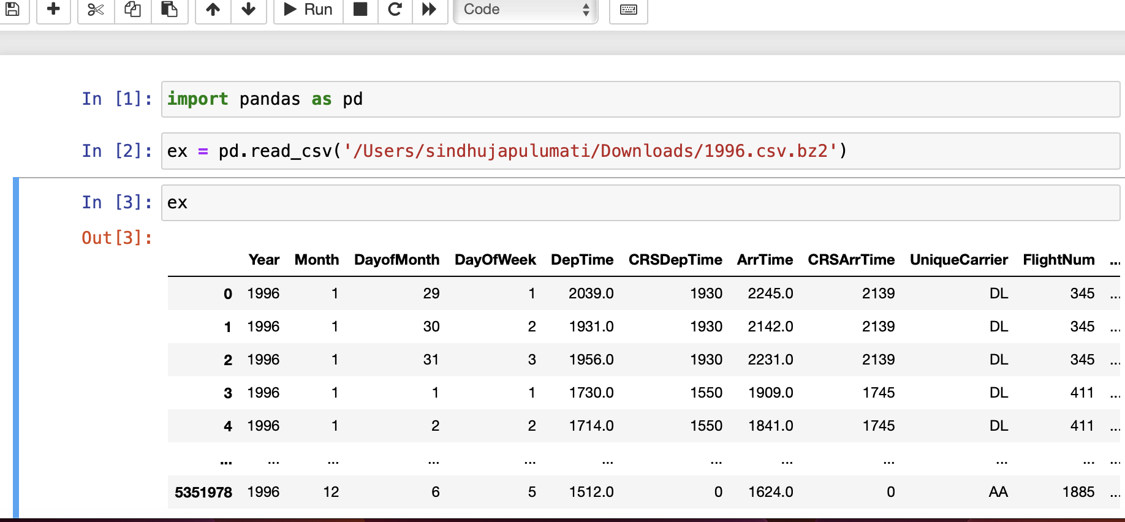
Python code for Sampling excel file for Year 1996

Slide 46
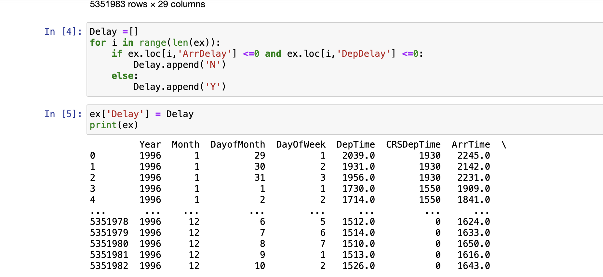
Inserting Delay column into the record

Slide 47
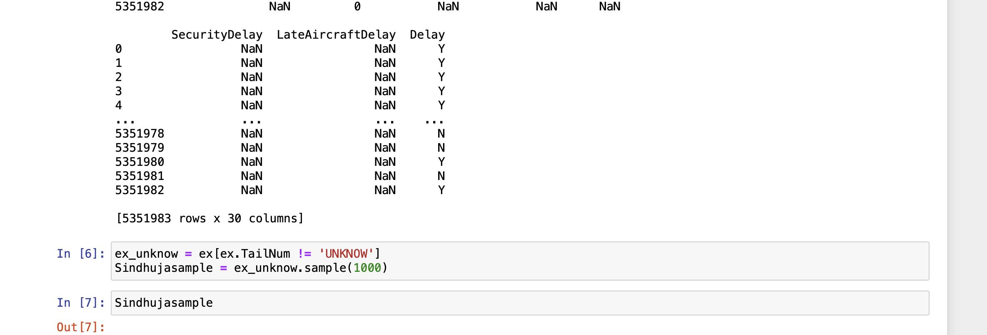
Displaying Sample of 1000 records

Slide 48
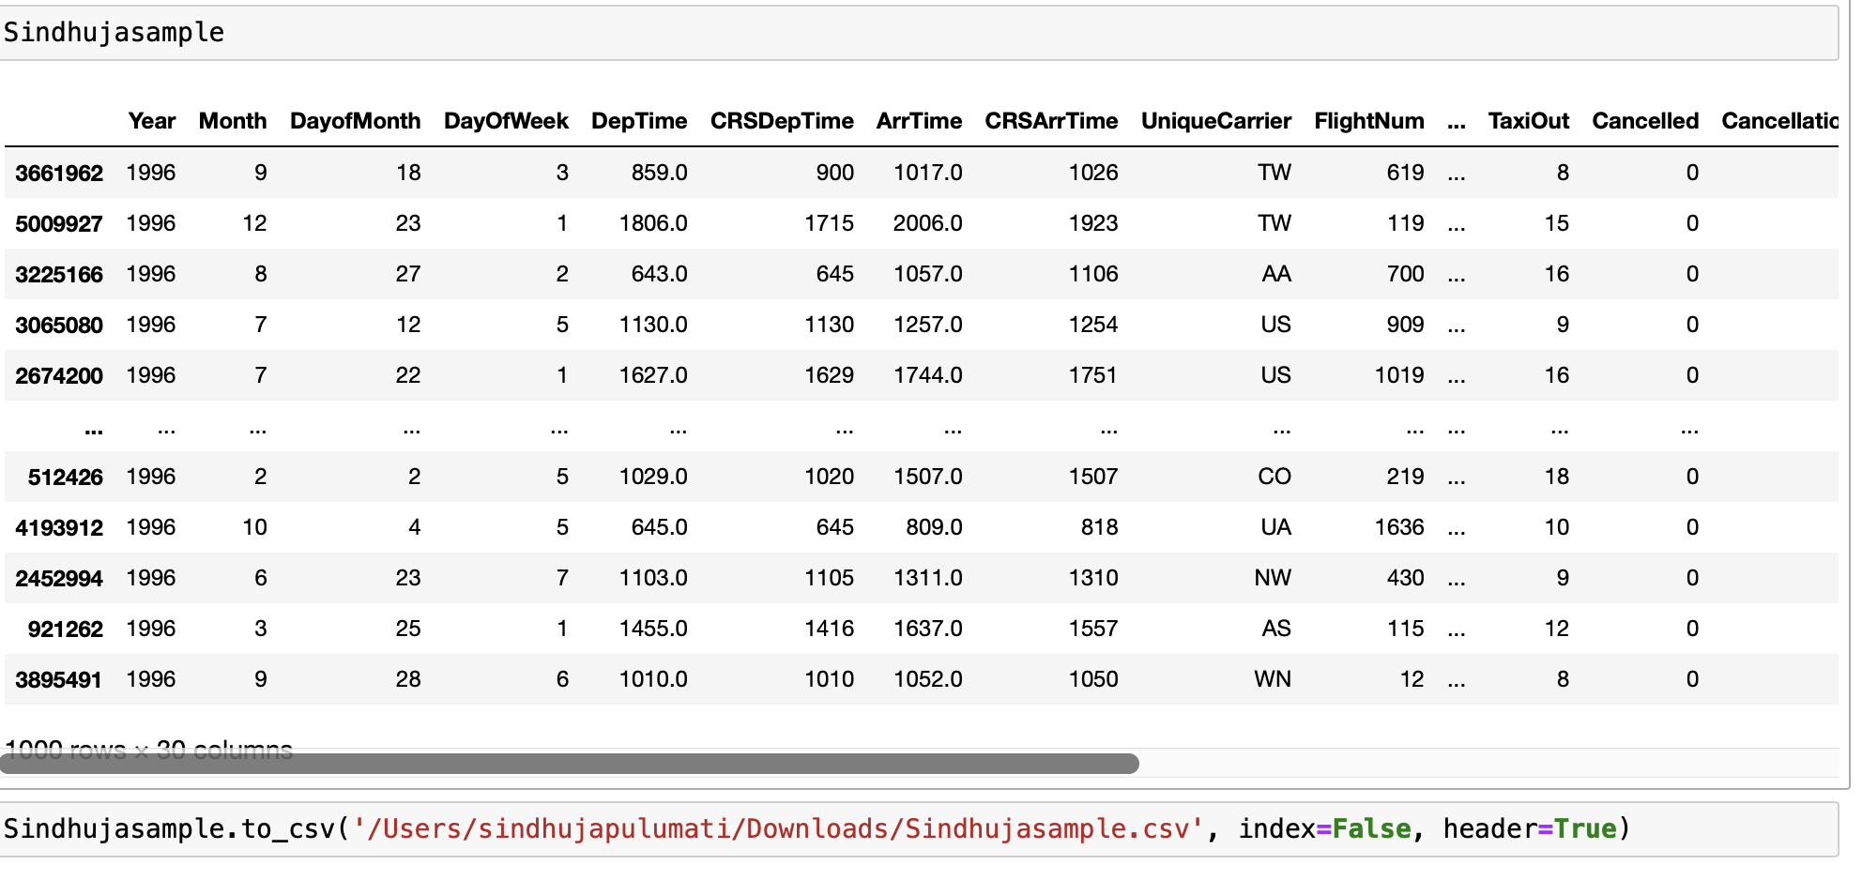
Loading CSV file to our machine

Slide 49
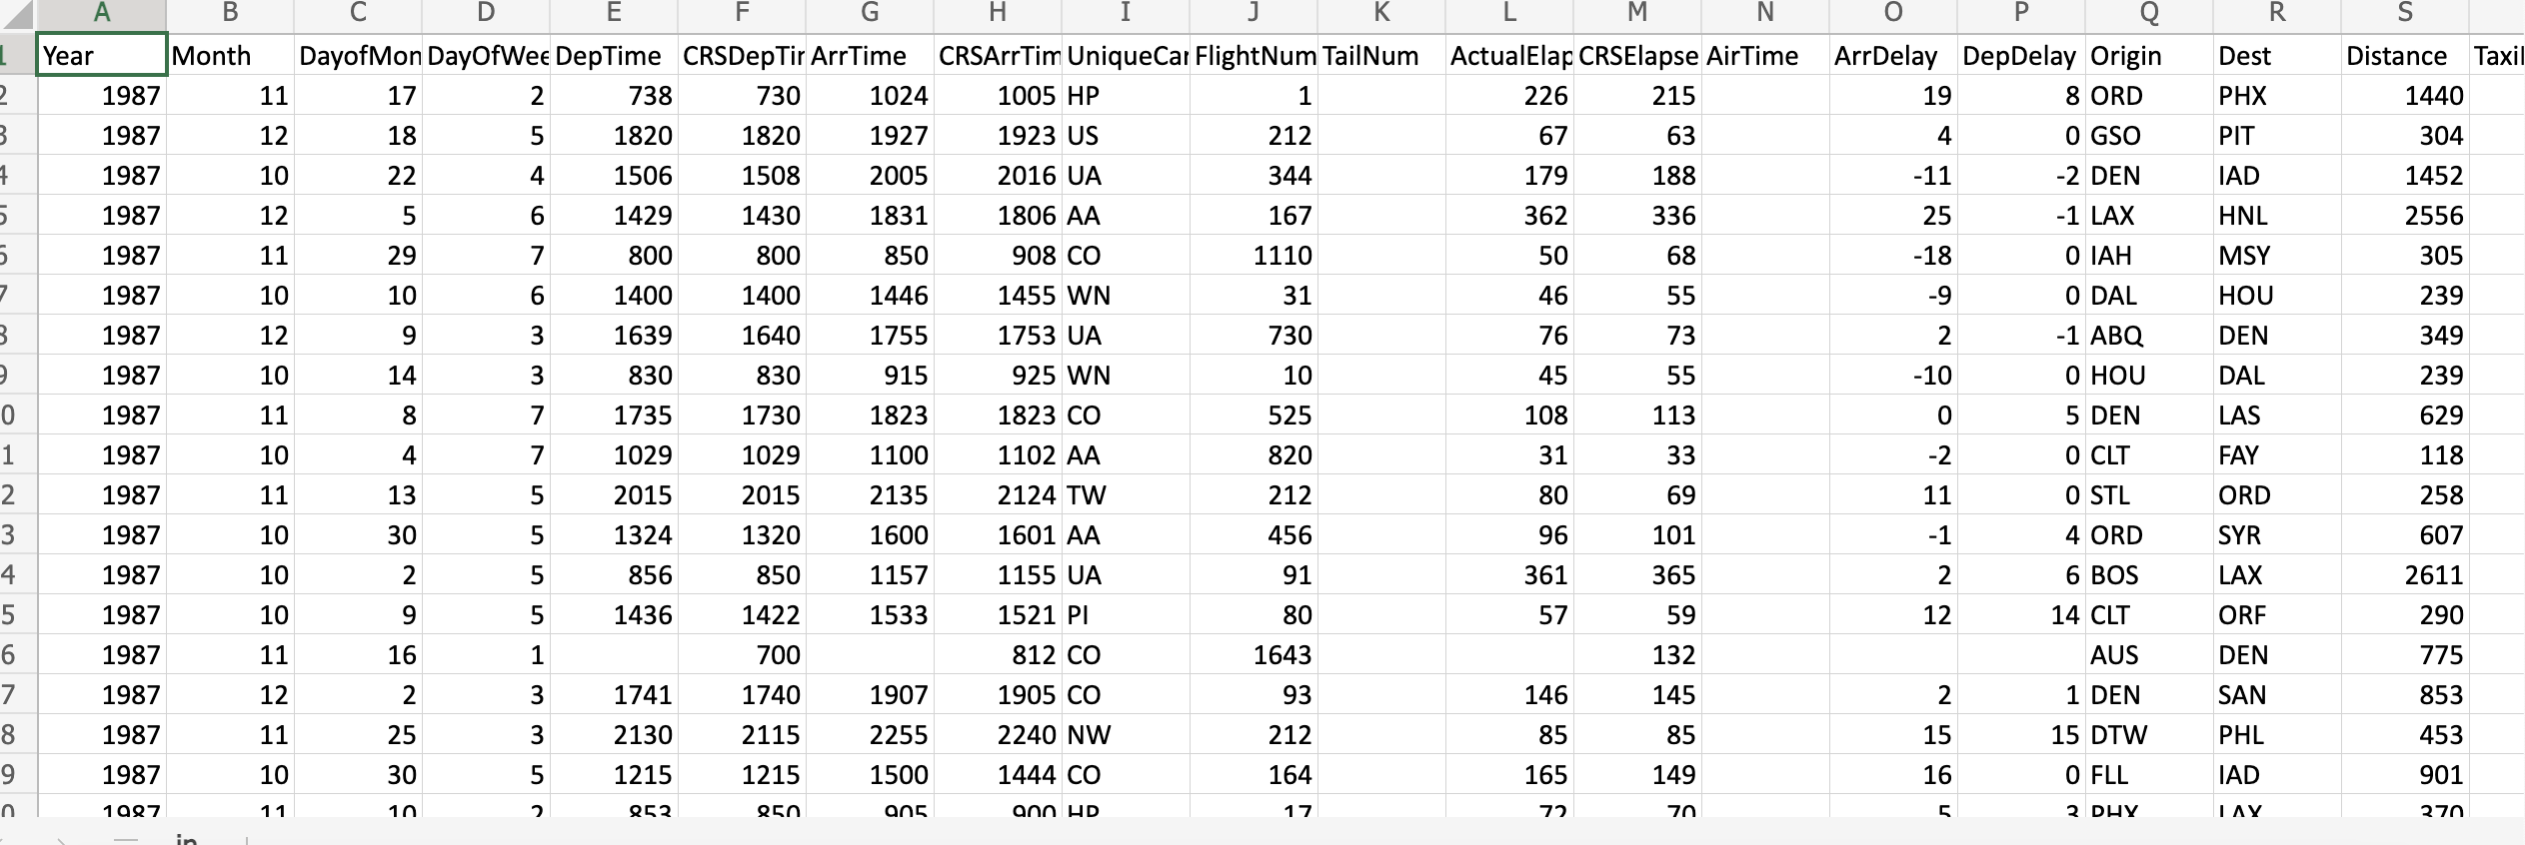
COMBINED EXCEL FILES USING EXCEL

Slide 50
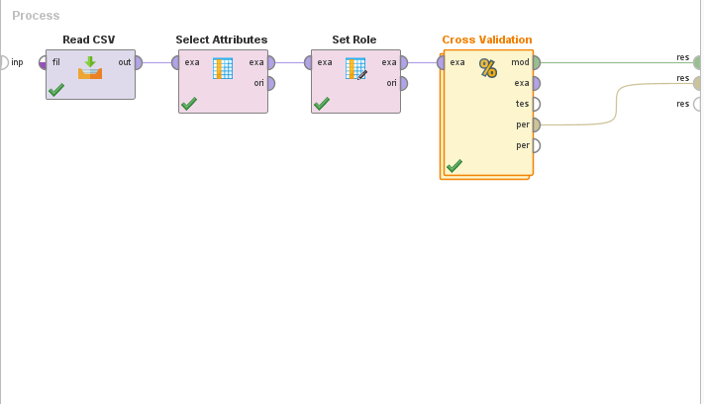
Design for Combined csv data

Slide 51
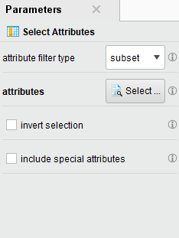
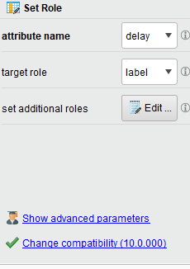
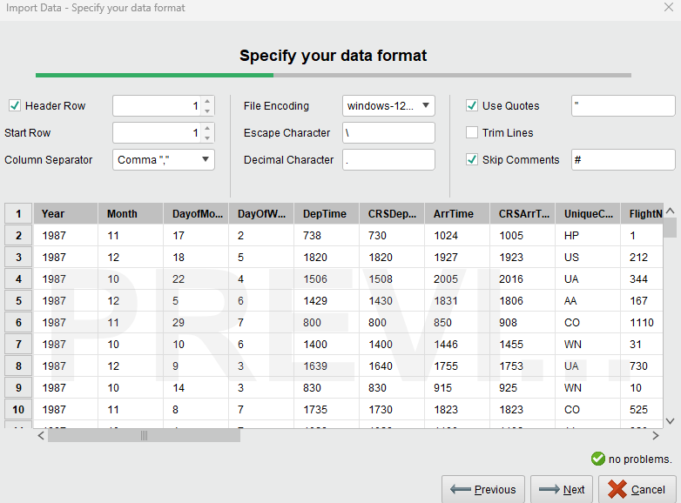
Assigning Parameters, roles and reading CSV file

Slide 52
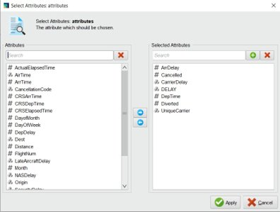
Selection of Attributes

Slide 53
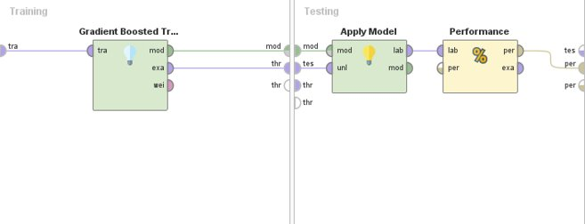
Cross Validation

Slide 54

Results: Accuracy vs Precision vs Recall Accuracy:90.28%

Slide 55

PRECISION: 89.54%

Slide 56

RECALL: 90.36%

Slide 57


Slide 58

Design for 12 Records

Slide 59


PARAMETERS FOR 12 RECORDS

Slide 60

Predicted 4Y and 8N values

Slide 61
RIYA SARODE YEAR 2001

Slide 62

CODE FOR Selecting 1000 random records for year 2001

Slide 63

DISPLAYING data in excel for year 2001

Slide 64
Combining data from all years

Slide 65
Combined data file in excel

Slide 66

RapiDminEr: importing, training and testing the data

Slide 67

Cross Validation

Slide 68

Attribute Selection

Slide 69

Graph of RANDOM FOREST MODEL

Slide 70

Performance vector

Slide 71

Result of 12 records

Slide 72
SHWETA SAWANT - 2006

Slide 73


SELECTING RANDOM 1000 RECORDS FROM ASSIGNED YEAR 2006

Slide 74

Adding a new column Delay Column and adding N if arrdelay and depdelay has value less than or equal to 0 otherwise adding Y
import pandas as pd
df = pd.read_csv('C:\Users\I1357\Downloads\\2006YRN.csv')
df['Delay'] = df.apply(lambda x: 'N' if x['ArrDelay'] <= 0 and x['DepDelay'] <=0 else "Y", axis=1)
df_1 = df.sample(n=1000)
print(df_1)
df_1. to_csv('C:\Users\I1357\Downloads\sample_2006YRN.csv')

Slide 75

DISPLAYING 1000 RANDOM RECORDS USING PRINT FUNCTION

Slide 76

EXTRACTING AND DOWNLOADING THE FILE TO LOCAL DEVICE

Slide 77

COMBINING THE FILES using excel:

Slide 78

Steps to load combined data into local repository in rapid miner

Slide 79

Creating a repository

Slide 80

Formating and storing the combined file in local repository

Slide 81

Model & flow : Deep learning

Slide 82

Selection of attributes:

Slide 83

Cross validation:

Slide 84

PERFORMANCE VECTOR: ACCURACY – 93.27 %

Slide 85

PERFORMANCE VECTOR: RECALL – 92.03 %

Slide 86

PERFORMANCE VECTOR: precision – 92.31 %

Slide 87

OUTPUT ON APPLYING DEEP LEARNING MODEL

Slide 88

Predicting the delay for 12 flight records

Slide 89

Selection of attributes for 12 records:

Slide 90

Output:

Slide 91
CONCLUSION
By examining all the following models we conclude that Decision tree model is much more convenient because it has a 94.82 percentage accuracy rate.

